Slide 1
Tip-Tilt Fiber Investigation of Ferrule breakage
Michael Lefebvre / LBTO AO Technician
November 29, 2014

Slide 2
Summary
During installation of the ARGOS fiber bundle in the RFBG Cable Wrap on 11/19/2014, one fiber ferrule was broken
The broken fiber assembly was removed and replaced with a spare assembly on 11/20/2014
The spare fiber assembly was successfully connected to AGW2 and routed into the LGS WFS rack on 11/25/2014
During fiber installation in the LGS WFS rack, (into APD receptacles), a second fiber ferrule was broken
Both ferrules broke in the same location
Fibers were handled by trained individuals using utmost care
Root cause failure of fiber ferrules given in this report
Fiber assembly manufacturer shall implement a corrective action plan to repair all cables (including spares) to mitigate nonconforming ferrules

Slide 3
Construction of Tip-Tilt Fiber Ferrules
Photo of unbroken fiber ferrules showing point of failure on both assemblies

Slide 4
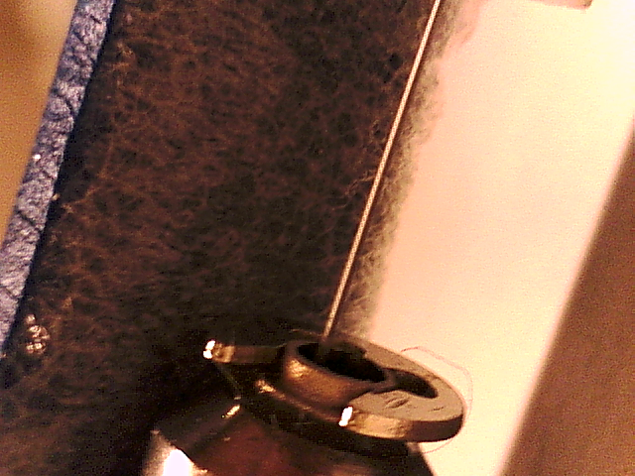
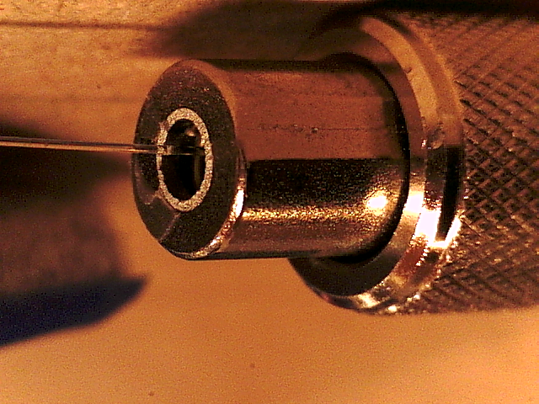
Broken Tip-Tilt Fiber Ferrule
Breakage on armored cable side Breakage on connector side
Break occurs at junction between armored cable and connector at snap ring
Wall thickness of broken piece is approximately 0.25 mm
Insufficient wall thickness is the root cause failure
Fiber assembly must be redesigned using more robust wall thickness of the offending parts to mitigate failure.

Slide 5
Interim Tip-Tilt Fiber Installation
Broken ferrule has been installed in the ARGOS LGS WFS rack as a temporary/interim solution
A corrective action plan shall be implemented to repair all cables (including unbroken spares) with these nonconforming ferrules

