Slide 1
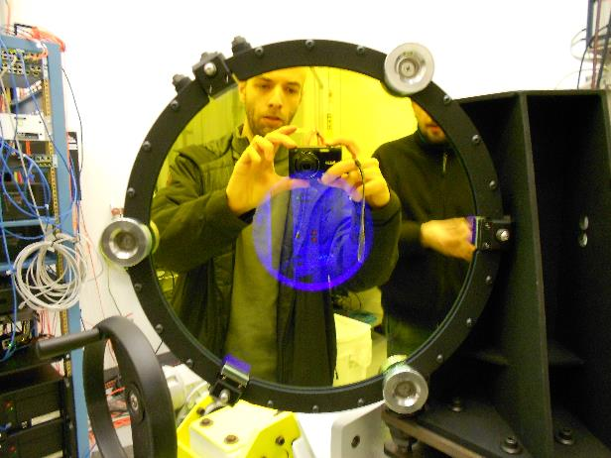
8am: start testing the corner cube mounts on DX cells

Slide 2
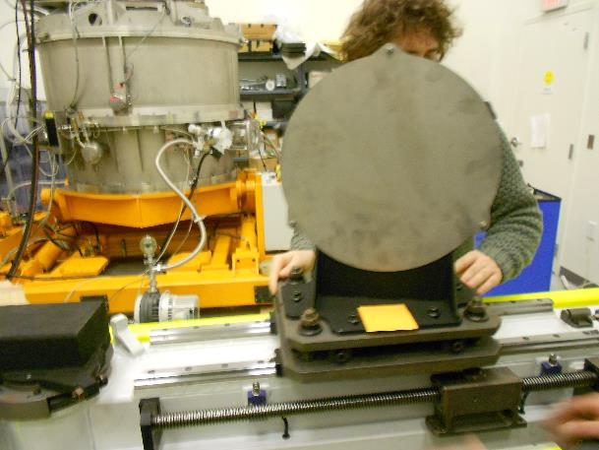
9am: dichroic rails cleaning and deployment test

Slide 3
9:30am: DX mount pulled out from clean room

Slide 4
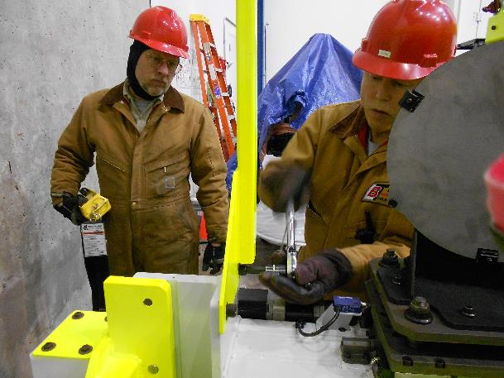
9:45am: DX mount attached to handling tool in high bay and lifted with dome crane

Slide 5
Total weight of the structure 432kg, preload to 388kg before loose M16 screws

Slide 6
9:56am: the DX mount is in the dome

Slide 7
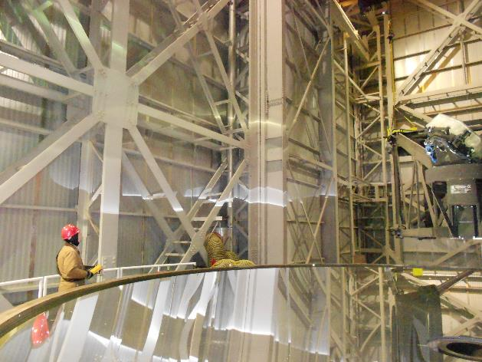
Fly over SX eye

Slide 8
Behind telescope, over gallery, over DX eye (10:05am)

Slide 9
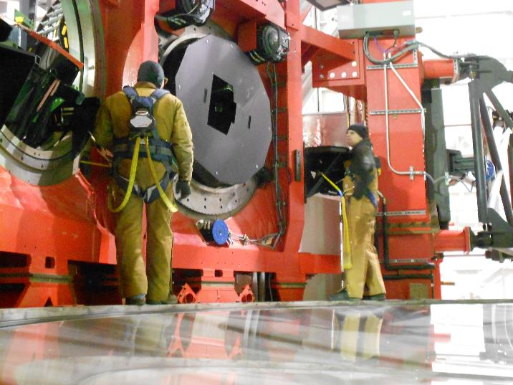
2 people dress up: 1 hanged to LBTI, 1 on LGSW table

Slide 10
10:15: the DX mount is pulled toward interfaces

Slide 11
It fits easily

Slide 12
10:22am: counterweight retracted

Slide 13
10:27am: halding tool removed

Slide 15
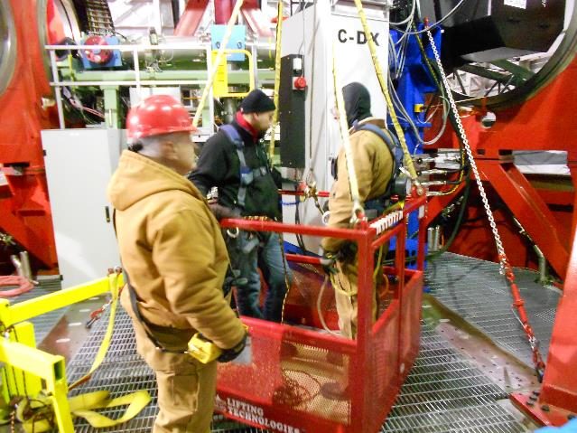
10:45am: 2 people are ready in the basket

Slide 16
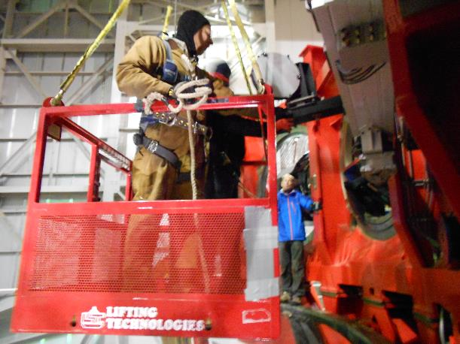
Basket approaches the DX mount to swing in the fold mirror: 2 people stabilize it with ropes

Slide 17
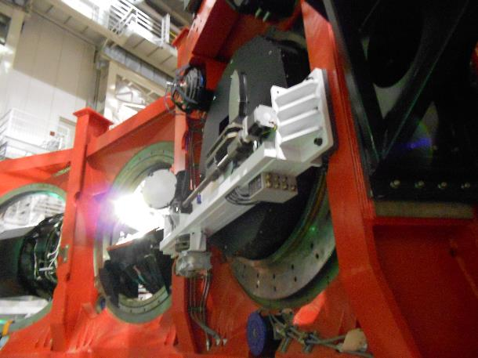
Fold mirror motor removed and arm retracted (10:56am)

Slide 18
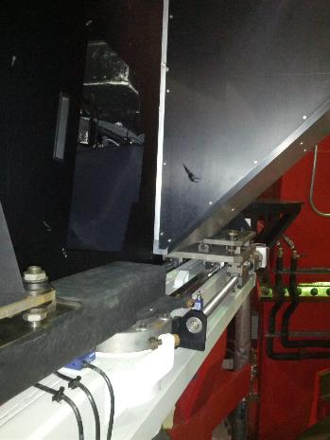
11:15am: LUCI 2 cal unit deployed -> OK

Slide 19
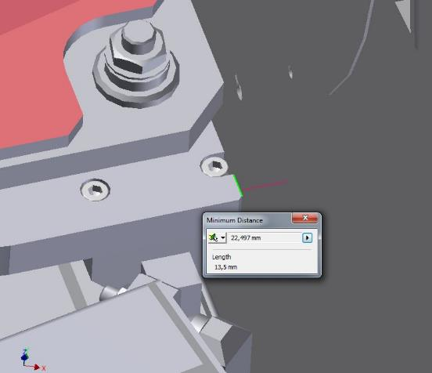
11:30am: LUCI 2 rotator moved by 360deg -> OK
25mm clearence to AGW cover(22.5 from model)

Slide 20
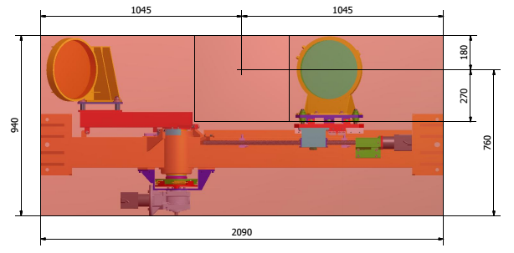
12am: LUCI 1 cal unit deplyed and distances to dichroic interfaces measured
786mm
1220mm
54mm ??
2016mm

Slide 21
1:15pm: horizon test for DX, LUCI 2 rotator moved by 360deg -> OK

Slide 22
1:30pm: unobstructed volume check (still to be measured from images, yellow tape is 50cm)

Slide 23
Afternoon:
SX mount in clean room
Dummies on SX cells with covers
Dichroic rails cleaned and cart slided
Connectors label plate installed
Fold mirror manually deployed
Rust inibitor on rusty parts (not done on DX mount!)
SX ready to be installed at telescope on Wednesday 5th

