Slide 1
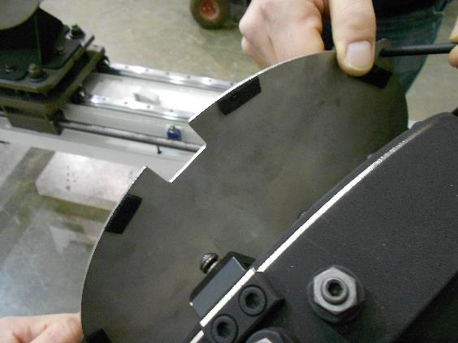
8:30am: start of activities in clean room: sticking foam pads to SX covers

Slide 2
9am: SX mount moved to high bay

Slide 3
9:20am: SX mount hanged to crane

Slide 4
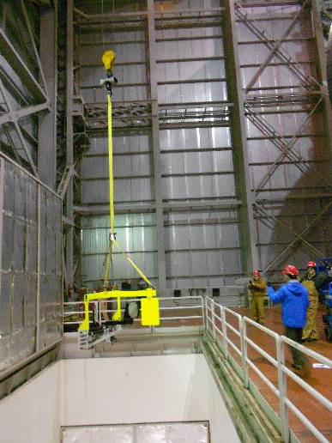
9:30am: mount in dome

Slide 5
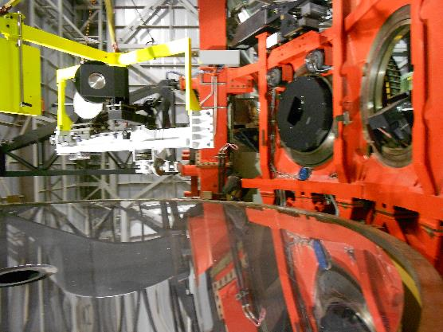

Slide 6
9:40am: crew ready for installation

Slide 7
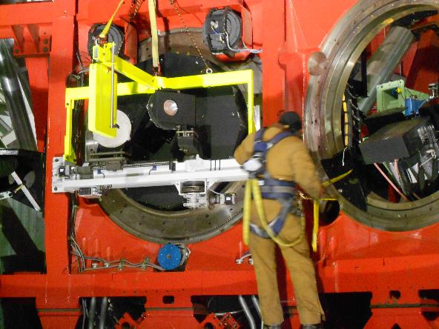
9:45am: mount fixed to instrument gallery

Slide 8
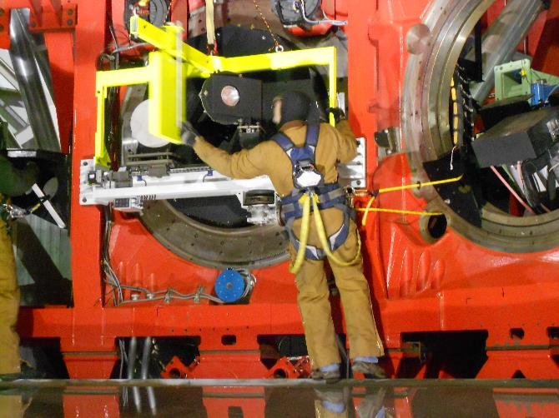
Counterweight retracted and handling tool freed

Slide 9
9:50am: handling tool removed

Slide 10
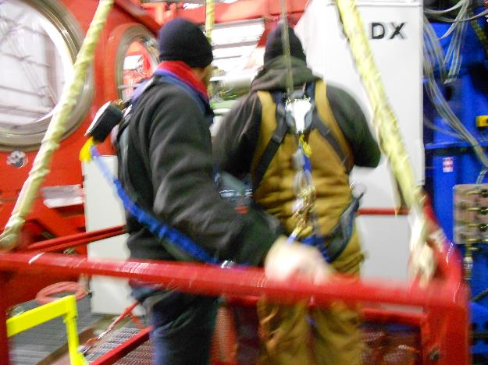
10am: basket ready

Slide 11
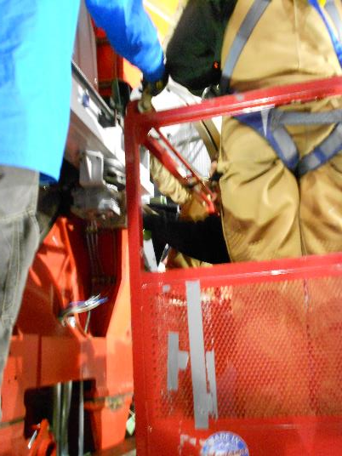
Pulling back fold mirror

Slide 12
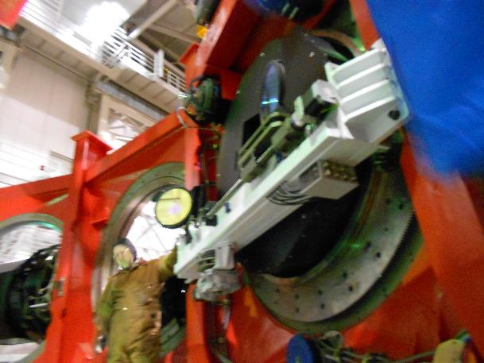
10:15am: removing covers from DX

Slide 13
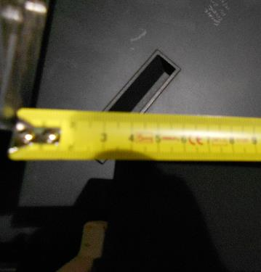
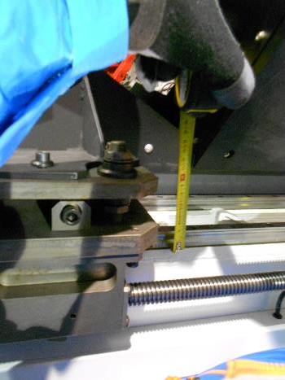
10:20am: LUCI1 cal unit deployed -> ok. Taking measurements of clearence

Slide 14
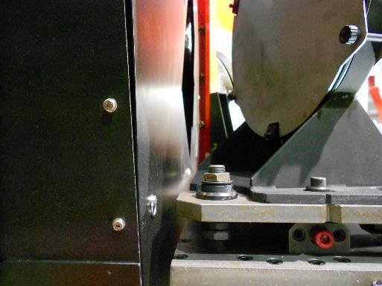
23mm from AGW cover to dichroic cart

Slide 15
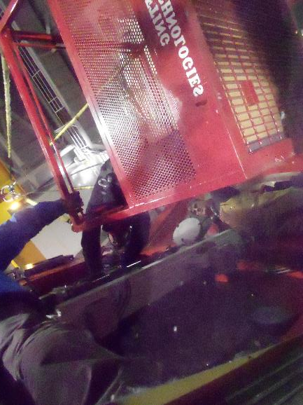
11:20am: DX covers reinstalled after putting foam

Slide 16
Taking 500mm clearence while in parking position (still to be measured on image)

Slide 17
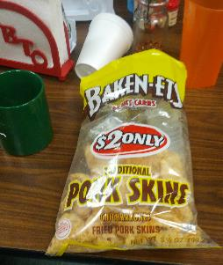
Pork skin™ effects on unprepared foreign

