Slide 1
Morning
Mainly lost due to power out
Alignment bar modified by Rick & Co.
Festo filter installed
Ethernet cable routed from DX threehouse to chamber
Power cord prepared

Slide 2
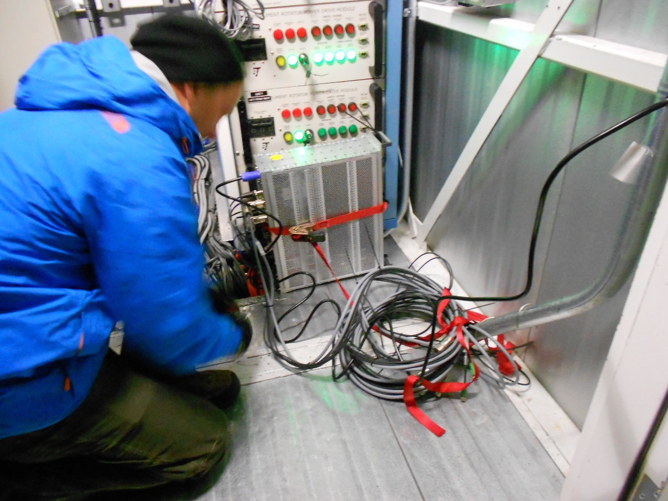
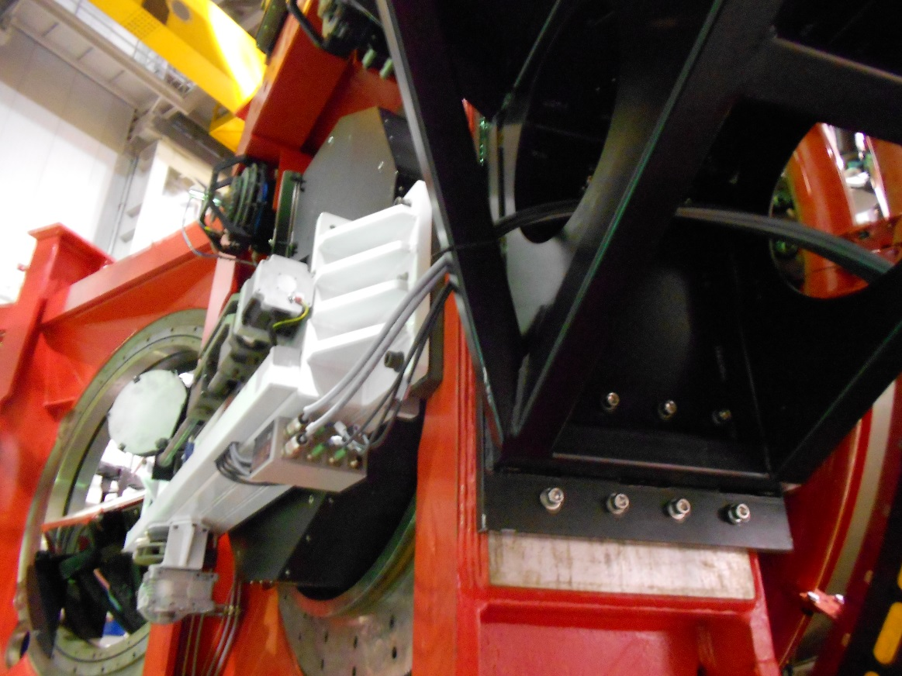
2pm: controller arrives on mountain
Installed and secured on DX threehouse
Cables routed below LGSW table (almost final routing)

Slide 3
2-7pm: DX mount first test
Functionality test at zenith in manual mode
Functionality test at zenith in remote
Functionality test at horizon
Checked procedures for stress test (we have done just 2 subsequent movements, stress test should last 1-3hours)
Setup AoEng laptop to operate the controller
Prepared setup to operate the AoEng laptop from control room using webcams (-8°C in dome!)

Slide 4
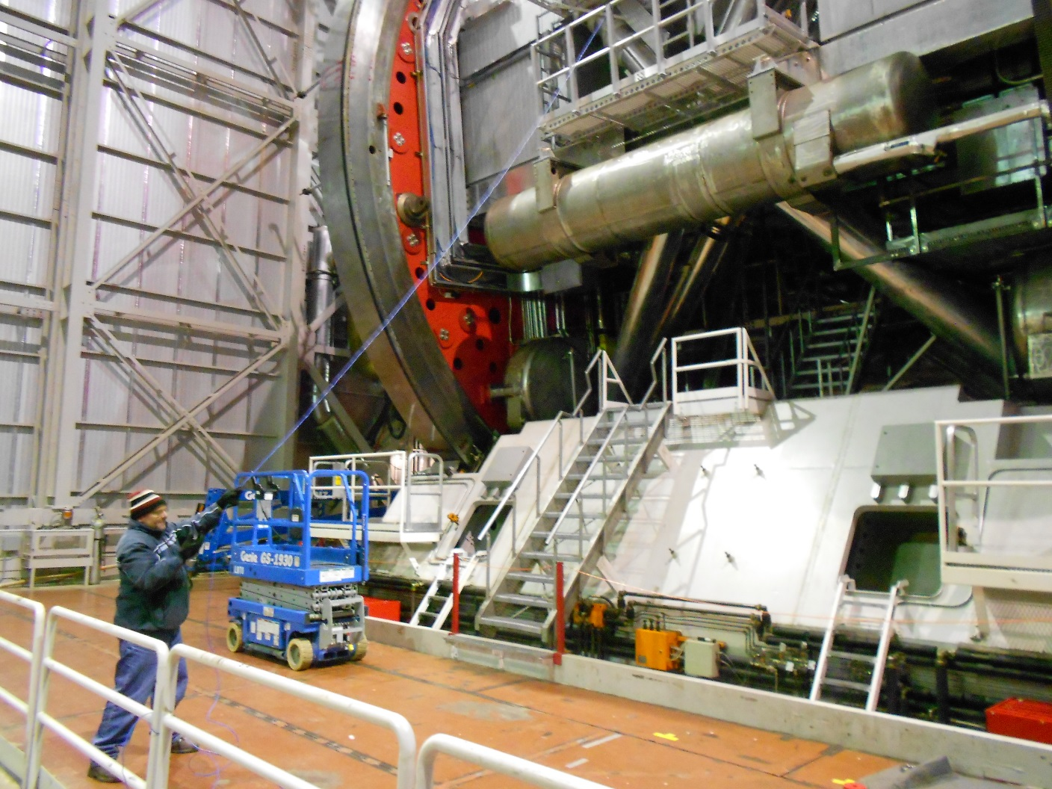
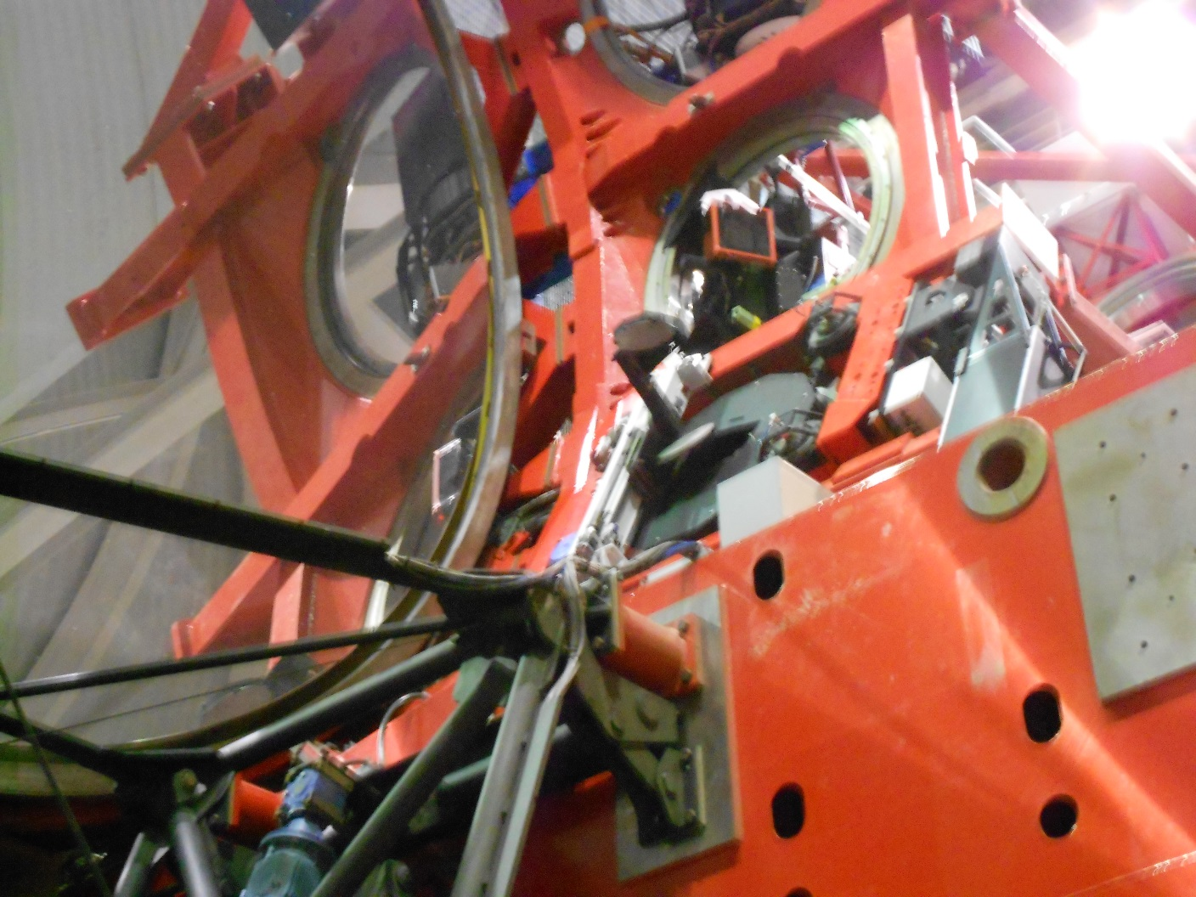

Slide 5
After dinner: Marchino pushes to write report

