Slide 1
8:30am: setup of laser tracker on DX side

Slide 2
9am: taking right front bend gregorian rotator as reference

Slide 3
10:45am: nest and optic installed on dichroic mount

Slide 4
Measurements in the parked and working position
Final erorr on dichroic tilt: -0,0046deg (15deg AOI direction)
Final error on dichroic tip: 0,0051deg

Slide 5
Table tilted by 1.2deg toward the gallery wrt the model
Shifted by about 30mm toward the gallery

Slide 6
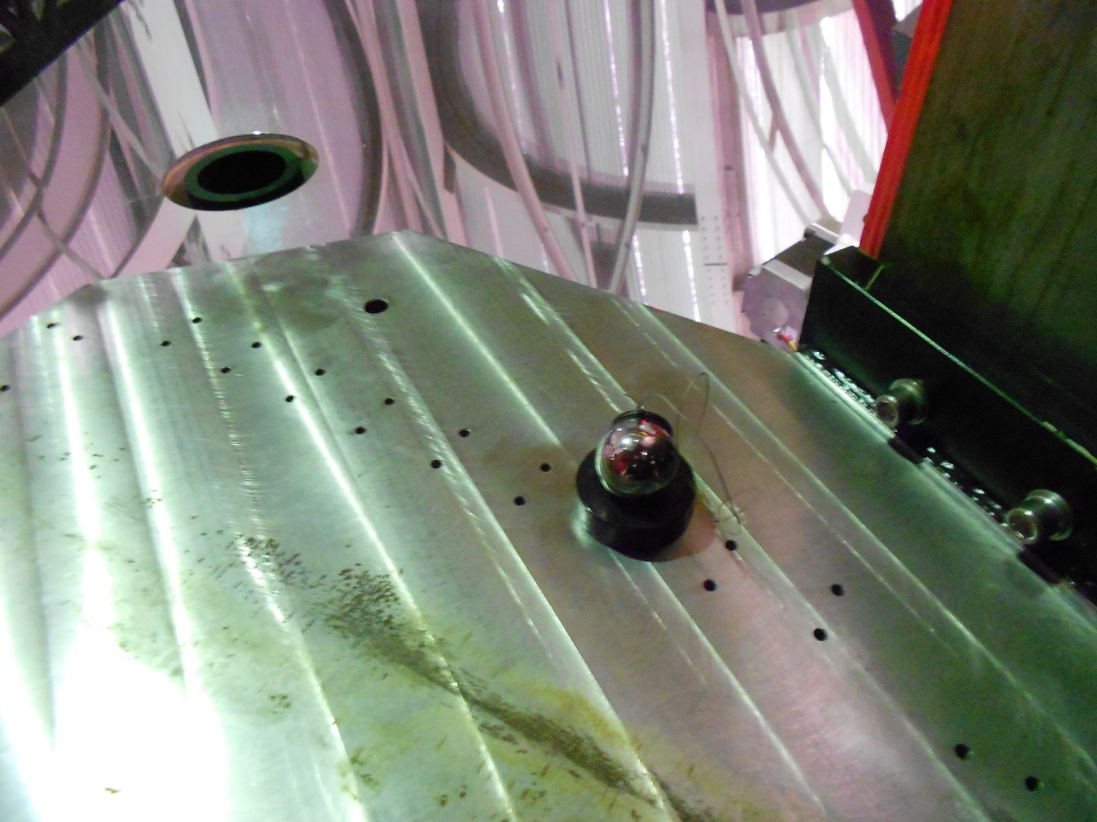
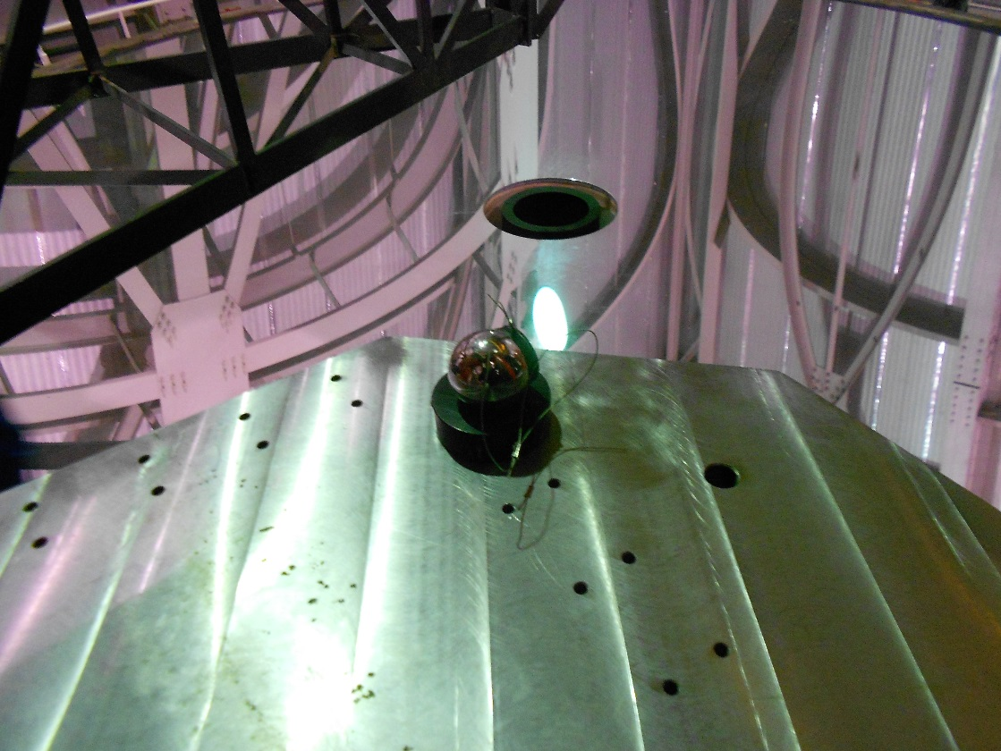
P1, P2 and P3 reference

