Slide 1
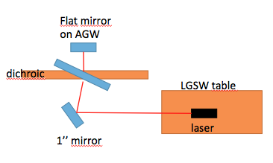
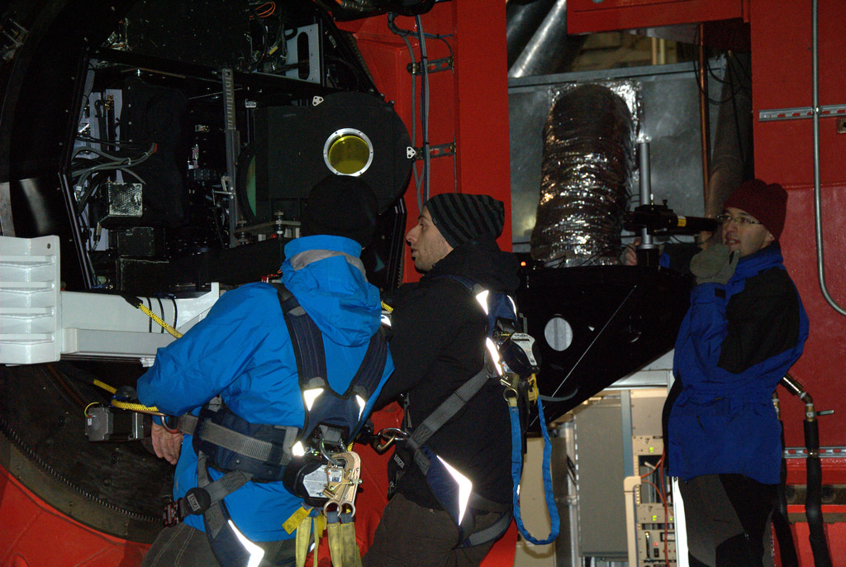
Autocollimation
Be sure to not vignette the beam reflected on the first surface of the dichroic

Slide 2
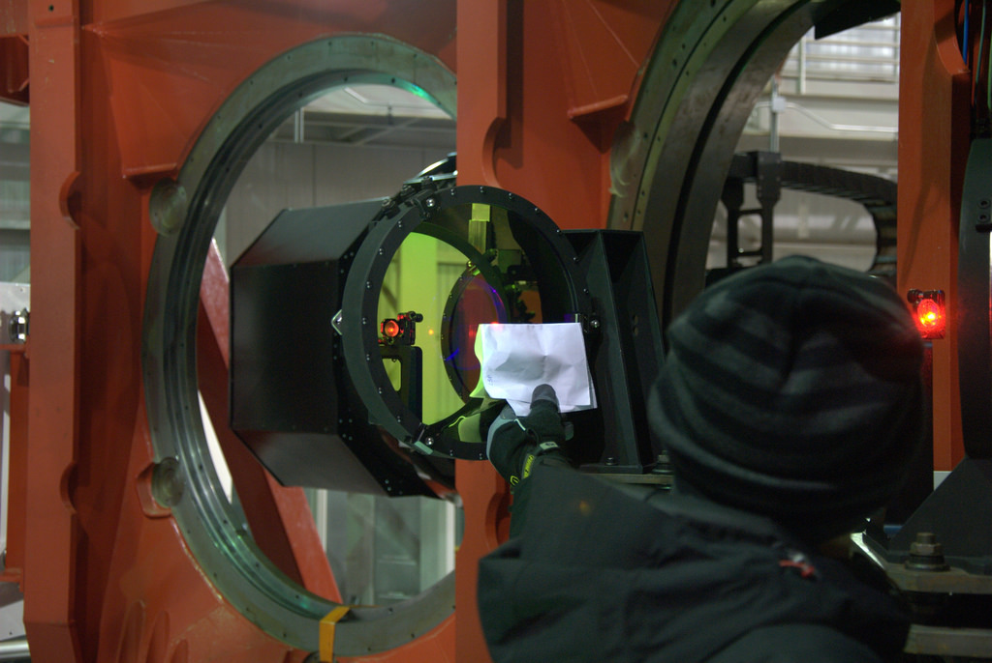
Beam centered on Fold Mirror
Fold mirror arm was adjusted until the beam is in the center. The good spot is the left one here. Accuracy <2mm is enough to avoid vignetting of the laser beams

Slide 3
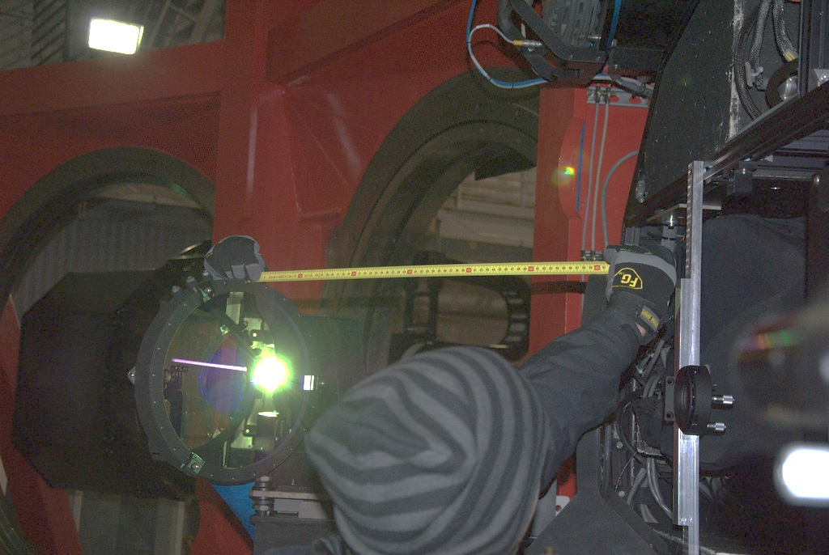
Dichroic – Fold mirror distance
Distance between dichroic and fold mirror confirmed to be 600mm as nominal

Slide 4
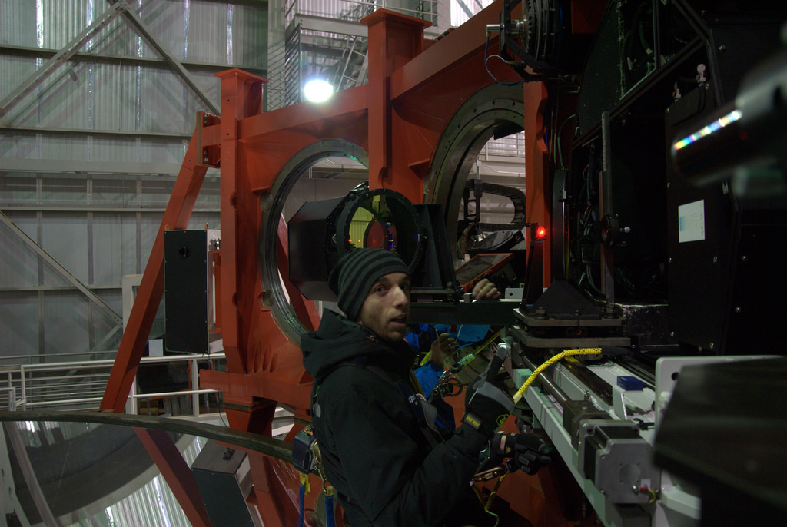
Fold mirror tilt adjusted
Fold mirror tilt is adjusted until the desired position of the beam on the wfs table is reached.

Slide 5
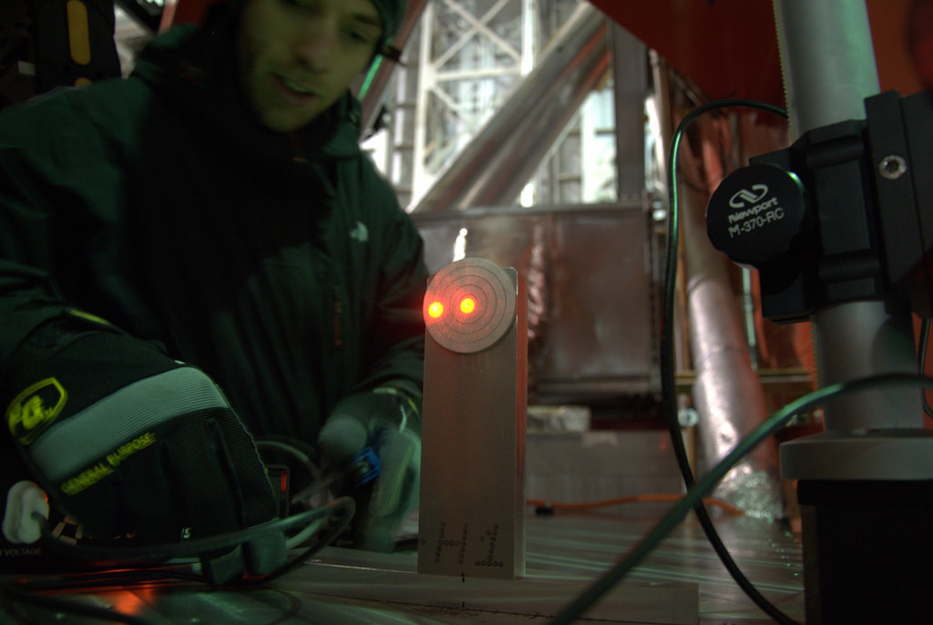
Rail positioned on WFS table
A rail is positioned to have the target centered on the beam.
The rail will serve as lateral reference for positioning the LGSW.
On the table the good spot is the one on the right.

Slide 6
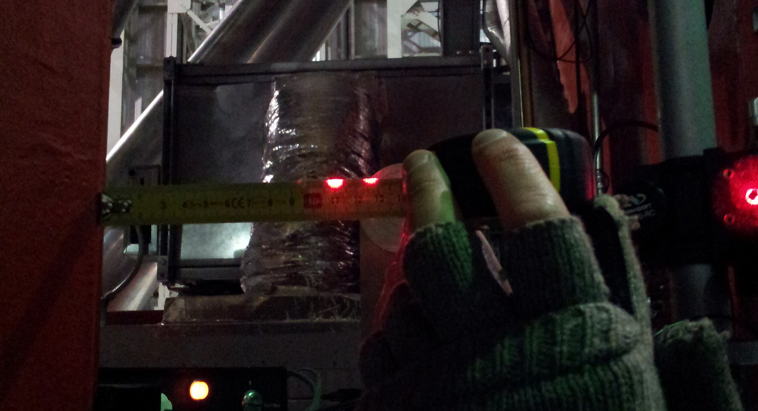
Measure beam position on the table
Beam passes at 127mm from the gallery corner. The distance from the on-axis beam and the outmost field on the patrol camera is 94mm.
So we should have a margin of 33mm

Slide 7
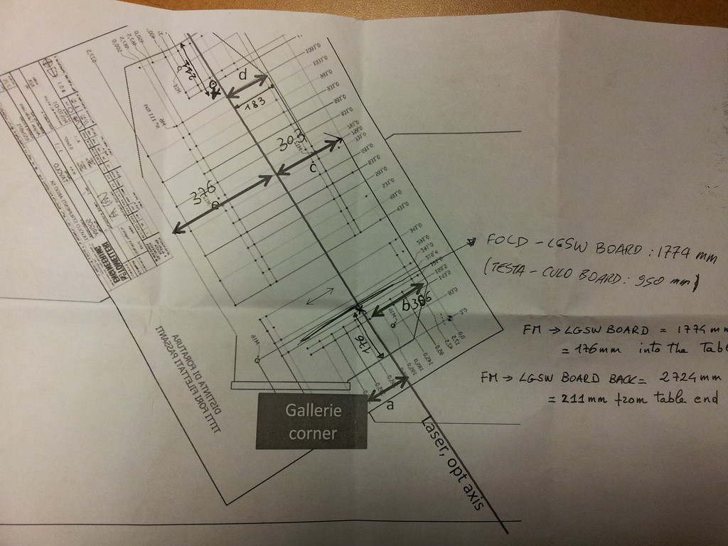
On the entrance focal plane beam is 11mm towards gallery wrt to table axis (306 vs 295mm)
Beam adjusted to pass from nominal position here
Focal plane position was measured with a ruler
LGSW board must be positioned
176mm into the table
From the end of the board to the end of the table the margin is 211mm
a=127mm

Slide 8
Summary
The optical axis has been adjusted on the table in such a way that it passes from its nominal position at the back of the LGSW where the WFS camera is placed and where volume constraint is bigger.
At the f16 focal plane the beam is offset by 11mm from its nominal position on the table toward the gallery edge. The beam angle wrt to the table axis is 0.6°: this deviation from the nominal position is not an issue for what concern envelope and clamping of the LGSW.
The beam is centered on both the dichroic and the fold mirror <2mm and passes at 127mm from the gallery edge, leaving 33mm of margin before vignetting the patrol field.
The height of the beam over the table is 150±1mm, angle<5’
An estimate of the global error done in materializing the rotator axis over the table is 2mm offset and 7’ angle.

