Slide 1
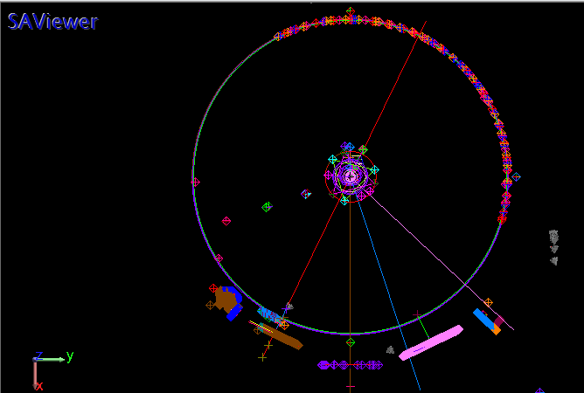
Setup of laser tracker on DX side
NOTE:
X axis along M1s centers, towards SX
Z axis along M1-M2 centers, towards M2

Slide 2
Taking right front bend gregorian rotator as reference
Corner cube and nest glued to rotator flange.
Rotator moved and circle fitted to identifiy the axis.

Slide 3
Nest and optic installed on dichroic mount

Slide 4
Measurements in the parked and working position
Final error on dichroic tilt: -0,0046deg (wrt 15deg)
Final error on dichroic tip: 0,0051deg
Dichroic center offset wrt rotator axis: [0,0,-1]mm

Slide 5
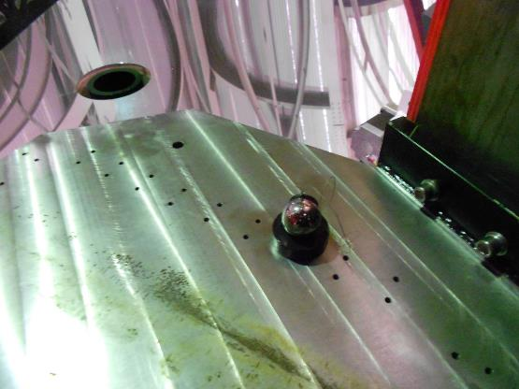
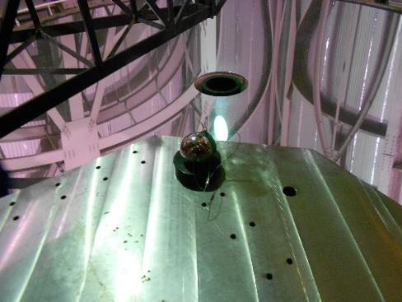
3 M6 holes position measured on DX table

Slide 6
Position of the M6 holes on DX table (to be compared with Matthias model)
P2: [-1217.5, -1618.0]
Table plane after repositioning to the end of the slot is 147mm below rotator axis (nominal 150mm)
P1: [-1077.2, -1043.6]
P3: [-780.5, -1079.0]
Reference: intersection point between the rotator axis and the rotator flange

Slide 7
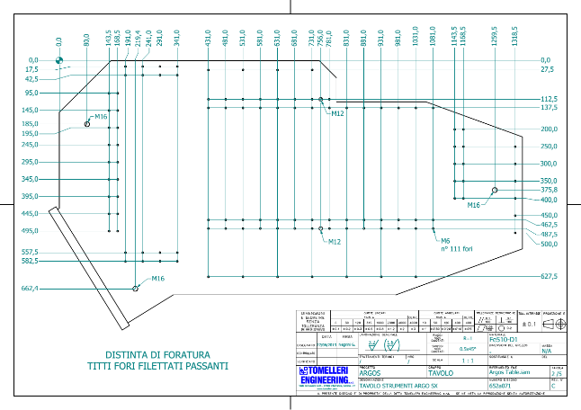
Position of the M6 holes on SX table (to be compared with Matthias model)
P2: [1232.4, -1633.3]
P1: [1092.9, -1059.8]
Table plane is 153mm below rotator axis (nominal 150mm)
-> To be repositioned: actually is at the end of the slot.
P3: [794.8, -1095.3]
Reference: intersection point between the rotator axis and the rotator flange

Slide 8
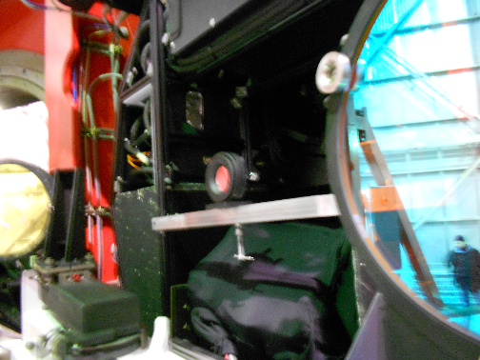
Rotator axis visualization on DX table: flat mirror installed on front of AGW

Slide 9
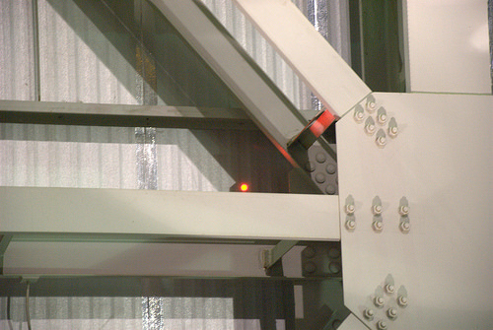
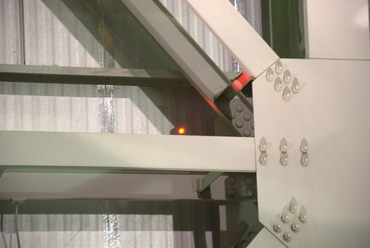
Rotator axis visualization on DX table: flat mirror aligned perpedicular to rotator axis
Laser beam projected across M1 to flat mirror and reflected on the dome
0deg rotator angle
180deg rotator angle

Slide 10
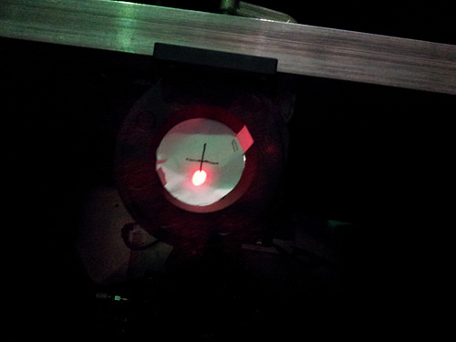
Rotator axis visualization on DX table: rotator axis visualized on the flat mirror
Laser beam projected across M1 and position marked at 0, 90, 180, 270deg of rotator angle
Center of 4 spots is the rotator axis (center of the cross)

Slide 11
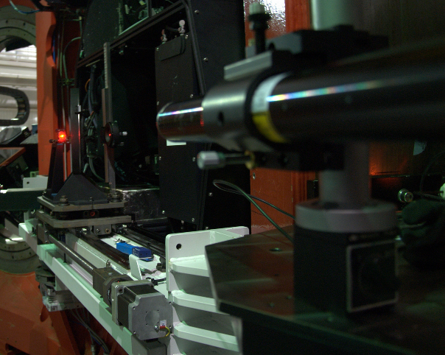
Rotator axis visualization on DX table: laser beam projected from table and autocollimated through dichroic
Flat mirror on AGW
dichroic
LGSW table
laser
1’’ mirror

Slide 12
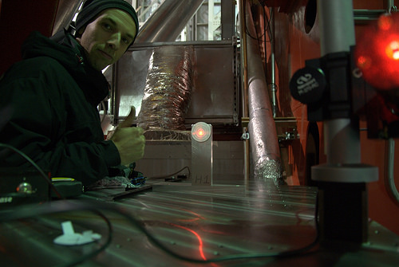
Rotator axis visualization on DX table: laser beam reflected by dichroic and fold mirror on DX table
dichroic
LGSW table
1’’ mirror
laser
Fold mirror

Slide 13
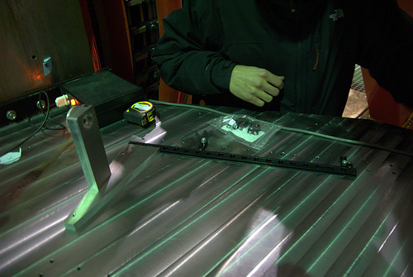
References installed for LGSW positioning
To be done: set beam height to 150mm tilting dichroic and fold mirror

