Slide 1
Mode #4
Mode #9
Mode #15
Mode #21
Mode #28

Slide 2
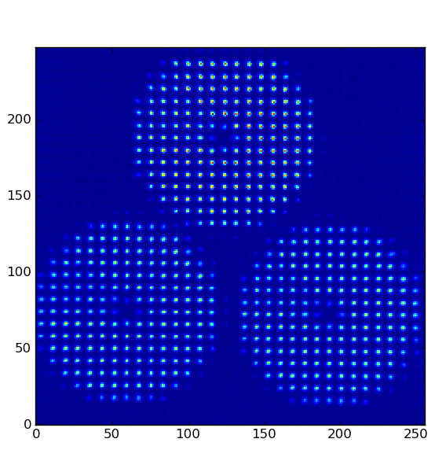
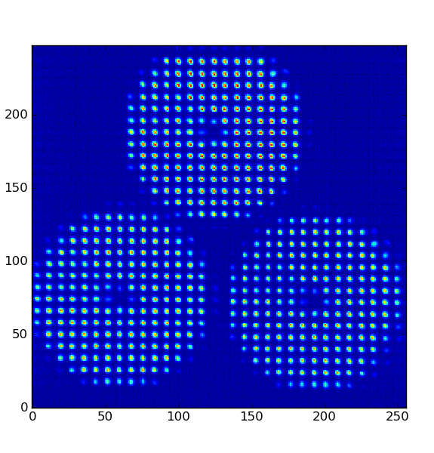
20150227_130159
20150227_132601
Avg flux per pupil= [3600,3200,3100]
Avg flux per pupil= [3600,3300,2700]

Slide 3
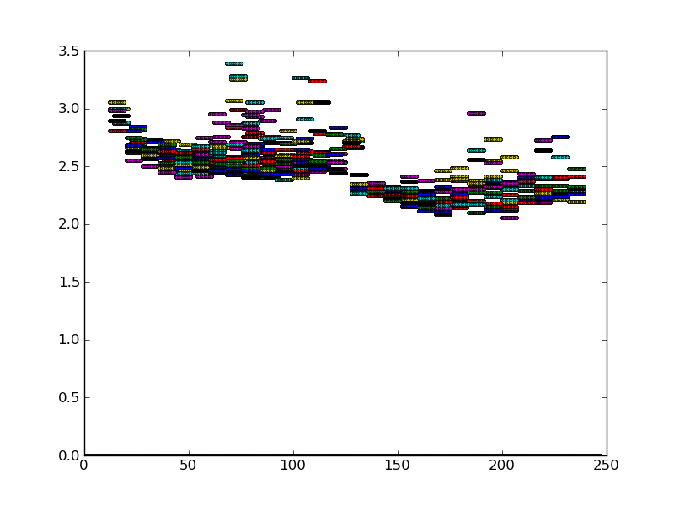
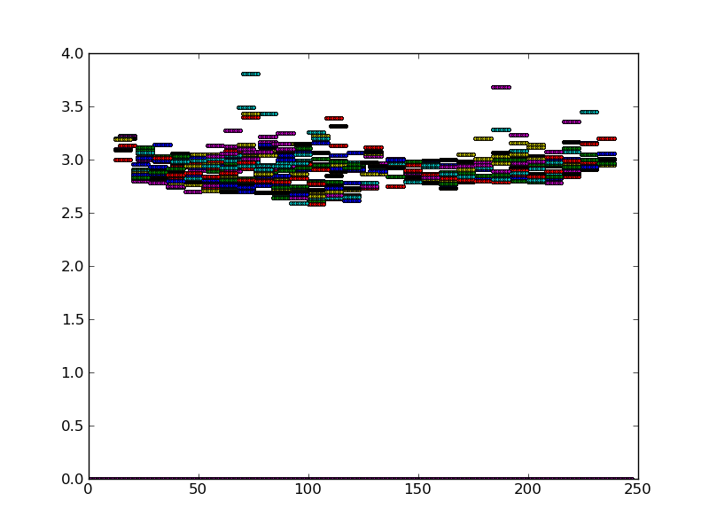
20150227_130159
20150227_132601

Slide 4
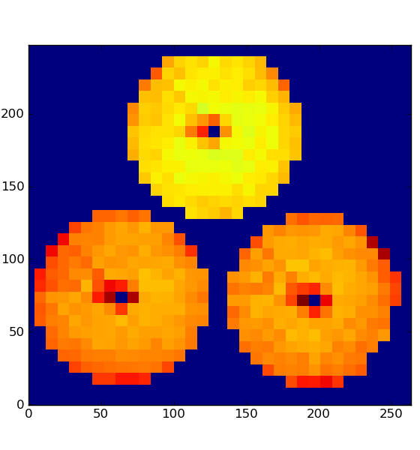
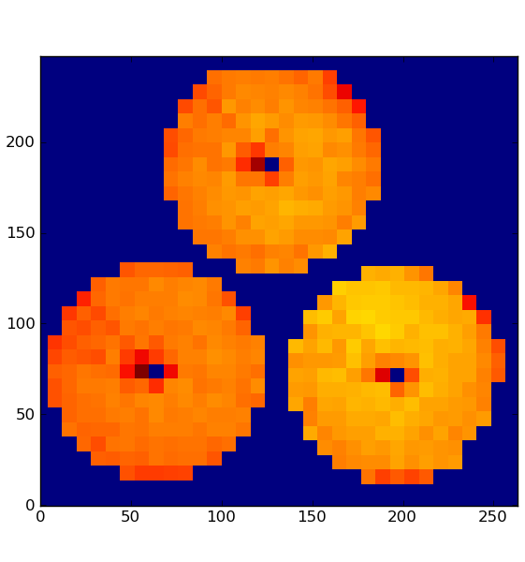
20150227_130159
20150227_132601

Slide 5
